Slide 1
Missing the Red Flags in neck & back presentations
RUTH MARSHALL
Medical Director, SA Spinal Cord Injury Service
Clinical Professor, University of Adelaide

Slide 2
Objectives
No blame & no shame

Slide 3
Objectives
No blame & no shame
Provide insights into how & why red flags may be missed
Consider ways that we can miss less / pick up earlier
Cases to help us learn
Questions and (hopefully) answers

Slide 4
Insights
Too narrow differential diagnoses
Inadequate history
Incorrect imaging (or no imaging)
Not examining the patient
Not believing the patient

Slide 5
What can we do?
Listen to the patient describe their symptoms and the time frame
Collateral history
Examine the patient
Imaging
If treatment doesn’t work, review
Seek another opinion - refer

Slide 6
What to think about
Cervical stenosis
Lumbar stenosis
Thoracic disc or disease
Infection
Tumour
Myelopathy
Upper or lower motor neurone signs
Incontinence or retention

Slide 7
Examine the patient
Are there any neurological abnormalities?
Weakness
Foot drop
Asymmetrical or symmetrical weakness
Spasticity
Sensory change
Balance disorder
Bladder, bowel and sexual dysfunction
Pain

Slide 8
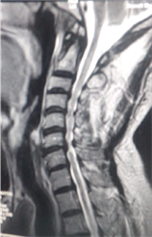
Cervical stenosis & myelopathy
This Photo by Unknown Author is licensed under CC BY
This Photo by Unknown Author is licensed under CC BY
This Photo by Unknown Author is licensed under CC BY-NC

Slide 9
Cervical stenosis & myelopathy
F 75yo increasing weakness upper limbs now
3 yr h/o faecal and urinary incontinence
not examined/not referred/ignored
Just ageing!
Alas it was too late to fix her neurogenic incontinence
Earlier MRI and referral could have made a difference!

Slide 10
Thoracic tumour
Intradural, extramedullary enhancing lesion

Slide 11
Cases
Case 1
Case 2
F59
LBP
12 mo h/o deteriorating LL function
No examination except MSK PT
Neuro physio noted UMN signs
Semi-urgent MRI ->urgent surgery
M71
>2yr h/o deteriorating LL function
Country region
No MRI
Eventually referred
Urgent MRI ->urgent surgery

Slide 12
What is it?
Case 3
F25 – h/o DVTs on warfarin
?? tumour
Slow bleed and compressive haematoma following a fall

Slide 13
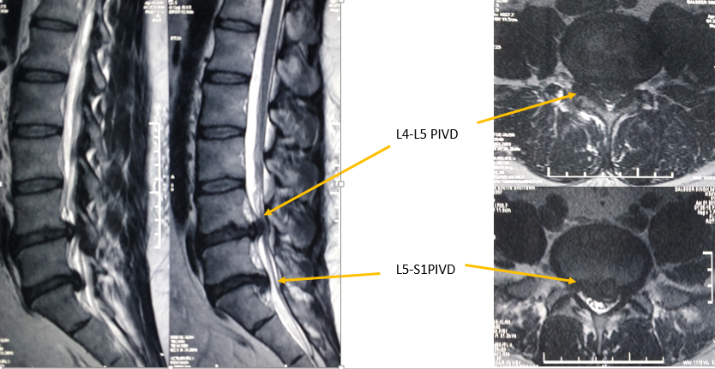
Lumbar spine
This Photo by Unknown Author is licensed under CC BY
This Photo by Unknown Author is licensed under CC BY-SA-NC

Slide 14
Cauda equina syndrome
Often associated with h/o LBP but not always
May be ignored by patient and medical professionals
Most common RED flag
Needs emergency intervention if
Perianal or perineal sensory loss
Urinary retention or incontinence with sensory loss
Faecal incontinence

Slide 15
Multiple cases
Case 4
Case 5
F37 – difficult confinement 5.5kg baby
LBP
Severe pain
Loss of perineal sensation
Sent home from ED
Huge disc protrusion
10 years later – still impaired
F50 – acute on chronic pain
Private hospital
MRI – large disc
No check of B&B – incontinent
Mobility impairment
Bladder & Bowel impairment
Severe pain
15 years – still impaired

Slide 16
Other possibilities
‘Funny’ infections or immunological disorders
Often the diagnosis is not clear
TB
Syphilis
Retrovirus
Corona
MS
Lupus
etc

Slide 17
Thank you for listening
AnY QUESTIONS?

